Slide 1
Chapter 5
Exception Handling

Slide 2
Exception Handling
Computer programs must handle unanticipated errors
No program should ever crash or quit working

Slide 3
Exception Handler
An exception is raised when an error occurs during the runtime execution of a program
What is needed to handle program exceptions?
An EXCEPTION section that includes handlers to trap and deal with all possible problems
Exception Handler:
Defines the recovery actions to perform when an exception is raised
Begins with EXCEPTION and placed at the bottom of the execution section

Slide 4
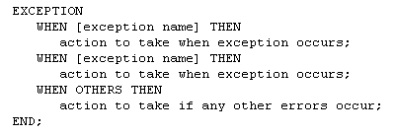
Structure of Exception Section

Slide 5
Exception Error Types
Predefined Errors
Non-Predefined Errors
User-Defined Errors

Slide 6
Predefined Error
A name assigned to about 20 of the most common errors
They do not have to be declared
Raised implicitly (automatically)
These predefined names are referenced directly in the exception section of the block
Examples – next slide

Slide 7
Predefined Error
Implicit Error Handling
Automatically by the Oracle server
Exception | Oracle Code | Example
NO_DATA_FOUND | ORA-01403 | A SELECT INTO statement returns no rows
TOO_MANY_ROWS | ORA-01422 | A SELECT INTO statement returns more than one row
ZERO_DIVIDE | ORA-01476 | Program attempts to divide by zero
DUP_VAL_ON_INDEX | ORA-00001 | Value inserted into a column defined with unique constraint is not unique
INVALID_CURSOR | ORA-01001 | An illegal cursor operation such as closing a cursor that is closed
INVALID_NUMBER | ORA-01722 | Attempted to store non-numeric data in a variable with a numeric data type
VALUE_ERROR | ORA-06502 | The value being placed in a variable is the wrong length or data type

Slide 8
Predefined Errors
DECLARE
v_last_name employees.last_name%TYPE;
BEGIN
SELECT last_name INTO v_last_name
FROM employees
WHERE job_id = 'ST_CLERK';
DBMS_OUTPUT.PUT_LINE('The last name of the ST_CLERK is : ' || v_last_name);
EXCEPTION
WHEN TOO_MANY_ROWS THEN
DBMS_OUTPUT.PUT_LINE ('Select statement returned multiple rows');
WHEN NO_DATA_FOUND THEN
DBMS_OUTPUT.PUT_LINE ('Select statement returned no rows');
WHEN OTHERS THEN
DBMS_OUTPUT.PUT_LINE ('Another type of error occurred');
END;

Slide 9
Non-Predefined Error
Do not have predefined names
i.e. NO_DATA_FOUND
Have ORA- error numbers
DECLARE section
Create name for non-predefined error
Associate name with ORA- error numbers using PRAGMA EXCEPTION_INIT function
Oracle raises error implicitly (automatically)

Slide 10
Non-Predefined Error – Two Examples
ORA-01400 cannot insert NULL
Error occurs when an attempt is made to insert NULL into a column defined as NOT NULL
ORA-01401 inserted value too large for column
The value entered is larger than the maximum length defined for the column

Slide 11
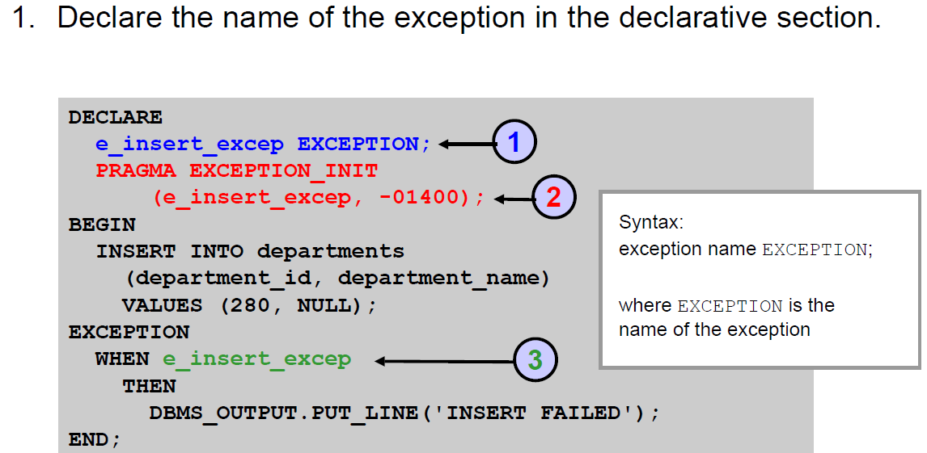
Non-Predefined Error
EXCEPTION - Datatype

Slide 12
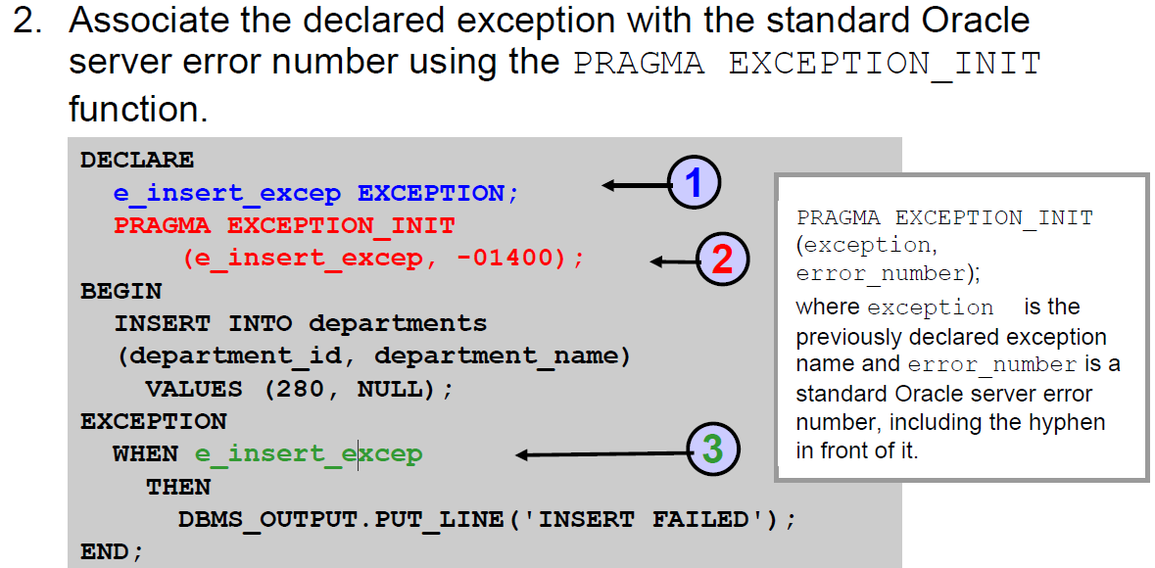
Non-Predefined Error

Slide 13
Non-Predefined Error
PRAGMA EXCEPTION_INIT
Associates an exception name with an Oracle error number
Can be used to intercept any ORA- error and write a specific handler for it instead of using the OTHERS handler

Slide 14
Non-Predefined Error
PRAGMA directive
Code is a non-executable compiler directive
An instruction to the PL/SQL compiler
Processed at compile time where necessary information is passed to the compiler; they are not processed at runtime
An abbreviation for pragmatic. Directive (programming), also known as a pragma

Slide 15
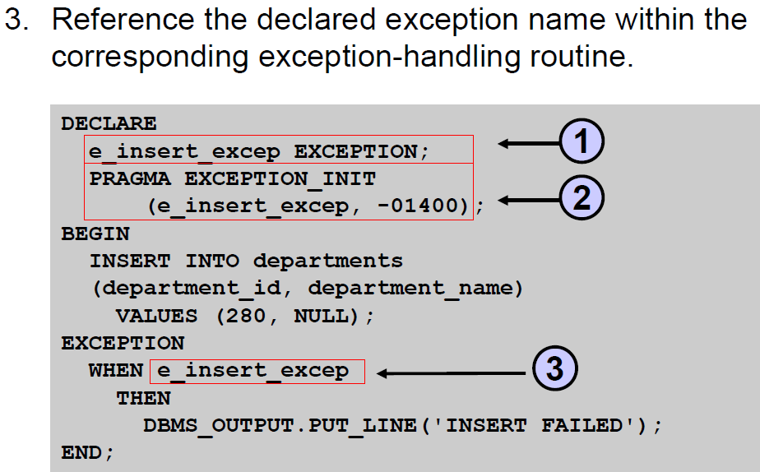
Non-Predefined Error

Slide 16
User-Defined Errors
Defined by the programmer
Specific to the programmer's code
Can define both an error code and an error message for user-defined errors
Errors unknown to Oracle
Named in the DECLARE section
Raised explicitly in the BEGIN (executable) section

Slide 17
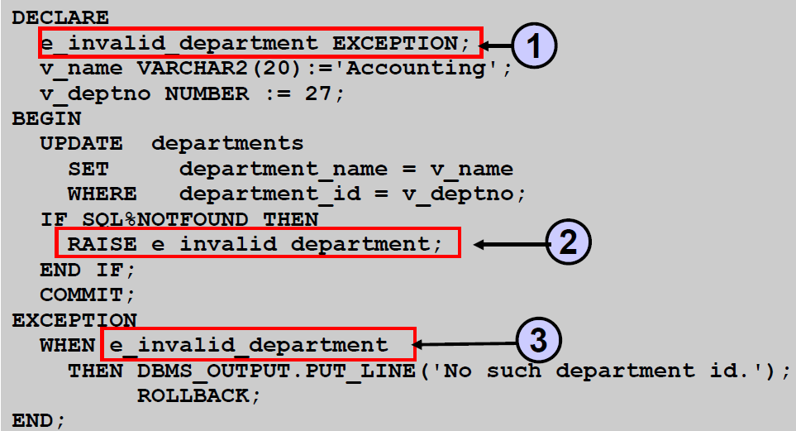
User-Defined Exceptions
1. The user-defined exception is declared in the DECLARE section
EXCEPTION is the datatype

Slide 18
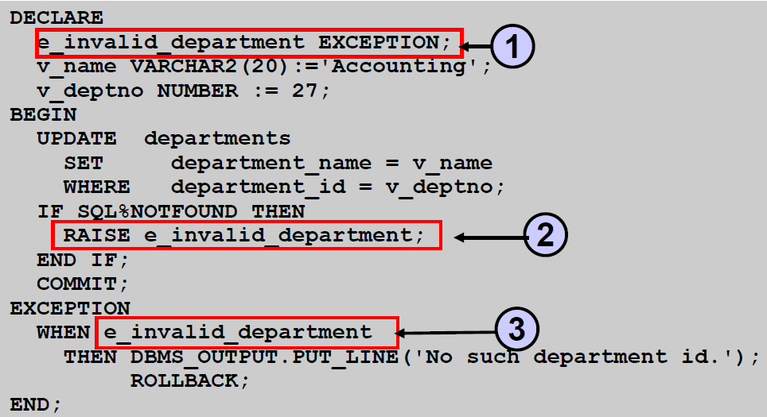
User-Defined Exceptions
2. The RAISE statement raises the exception explicitly within the executable section

Slide 19
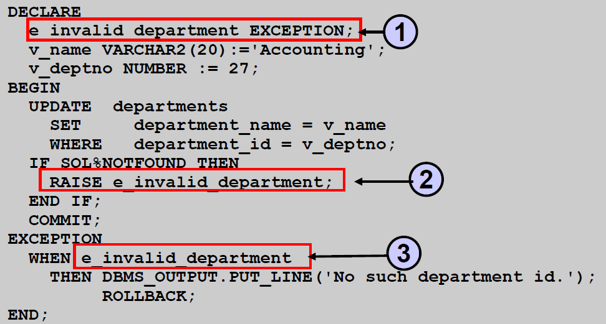
User-Defined Exceptions
3. Reference the exception within the EXCEPTION section

Slide 20
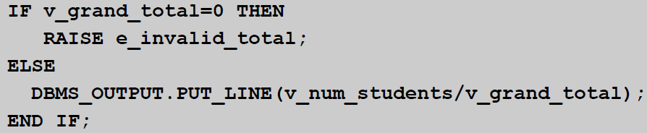
The RAISE Statement
Raise a named user-defined exception

Slide 21
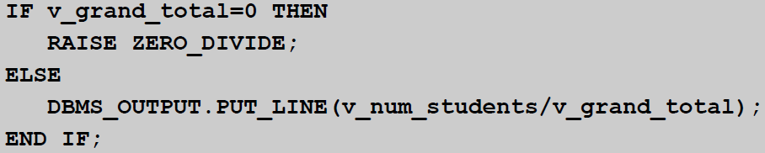
The RAISE Statement
Raise an Oracle predefined exception

Slide 22
RAISE_APPLICATION_ERROR Procedure
A procedure defined by Oracle that allows the developer to raise an exception and associate an error number and message with the procedure
Returns user-defined error messages
Advantage over RAISE statement
Associate your own error number and meaningful message with the exception
Error numbers must be between -20000 and -20999

Slide 23
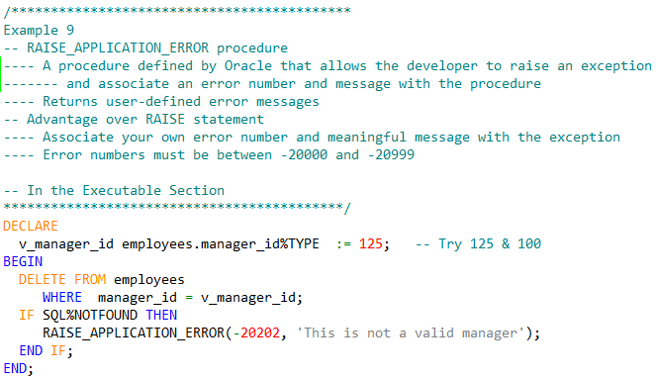
RAISE_APPLICATION_ERROR Procedure

Slide 24
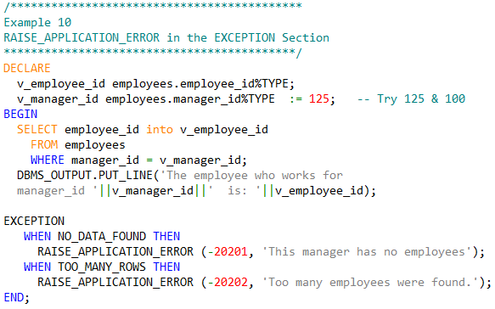
RAISE_APPLICATION_ERROR Procedure

Slide 25
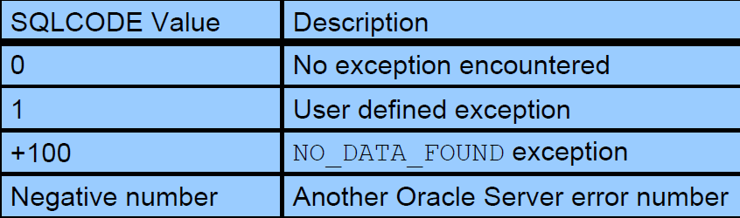
Retrieving SQLCODE & SQLERRM
When an exception occurs, you can retrieve the associated error code and/or error message:
SQLCODE returns the numeric value for the error code. (You can assign it to a NUMBER variable.)
SQLERRM returns the error message

Slide 26
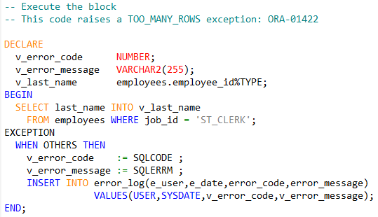
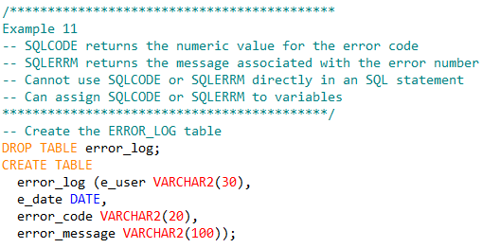
Retrieving SQLCODE & SQLERRM

Slide 27


